Slide 1
Music and Mental health EDA analysis
Chitramoy Mukherjee
DSC-530 T302 Spring 2023

Slide 2
Contents :
Introduction
Statistical question
Analytical steps
Dataset and Variables
Observations
Bibliography

Slide 3
Introduction :
When you’re feeling down in the dumps, music can help pick you up - much like exercise.
For every different mood there is different music. Now, to analyze how that helps mental health.
Research has shown that blood flows more easily when music is played. It can also reduce heart rate, lower blood pressure, decrease cortisol (stress hormone) levels and increase serotonin and endorphin levels in the blood
Research has shown that blood flows more easily when music is played. It can also reduce heart rate, lower blood pressure, decrease cortisol (stress hormone) levels and increase serotonin and endorphin levels in the blood
In this analysis we will perform similar exercise using ML technique and will show how listening to music boosts you or help you to come out of difficult situation/stress/anxiety.
Using the survey response received from various age people and based on that data, we will be analyzing different variables and will analyze the impact of one based on other variable in the dataset.

Slide 4
Statistical question:
What's the most popular music streaming service as per the survey.
Does most of the music listener likes to play instrument or music composer who listens music.
Analyze the MH ranking and OCD ranking based on the survey dataset.
Individuals that listen to music while working are more likely to explore new music and listen to music in different languages.
Does Older individuals are less inclined to explore new music.
How does music impacts on the respondents. Does it have a positive or negative impact.
What is the most popular genre of music as per the survey.
Which genre is most popular for which age group.
Is there any correlation between BPM and mental health.
How does the anxiety/Insomnia varies based on Age.

Slide 5
Analysis Step :
Understanding of dataset.
Identifying variables for analysis.
Histogram plot and identifying outliers.
Include descriptive characteristics about the variables.
compare two scenarios in data using a PMF.
Create 1 CDF with one variable.
Plot 1 analytical distribution and provide analysis.
Create two scatter plots comparing two variables and provide analysis on correlation and causation.
Conduct a test on your hypothesis using one of the methods.
Perform regression analysis on either one dependent and one explanatory variable.

Slide 6
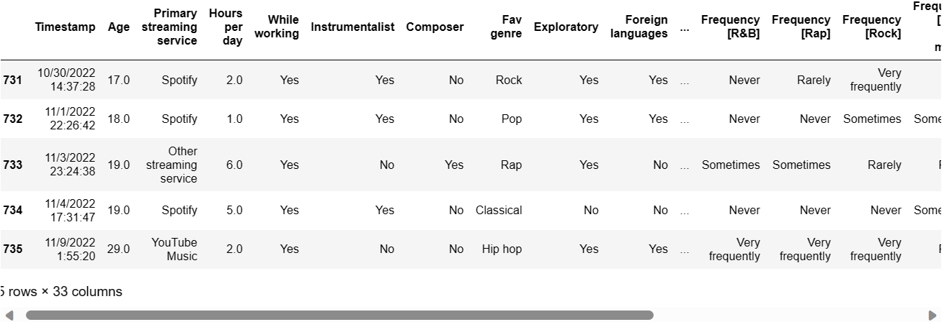
Dataset snippet:
Snippet of Input dataset used for analysis :
Variables :
Age
2. Hours per day
3. BPM
4. Primary streaming 5. service
6. Depression
7. Insomnia
8. Anxiety

Slide 7
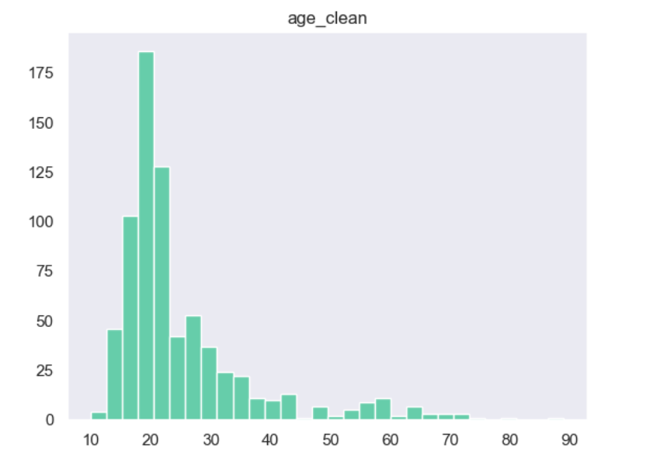
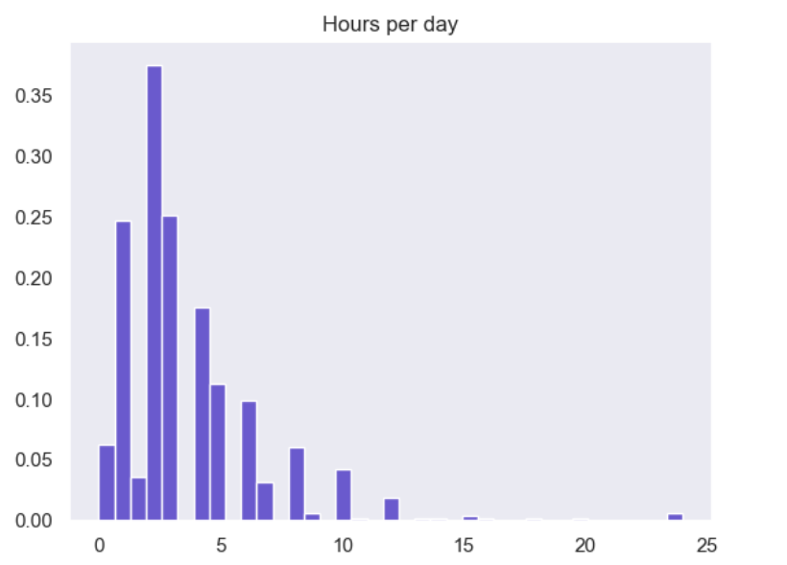
Histogram output:
Only one age shows 89 in the entire dataset, which considered as outliers.
Identified 3 outliers which are showing hours per day music listening as 24 Hrs in the hours per day histogram plot.

Slide 8
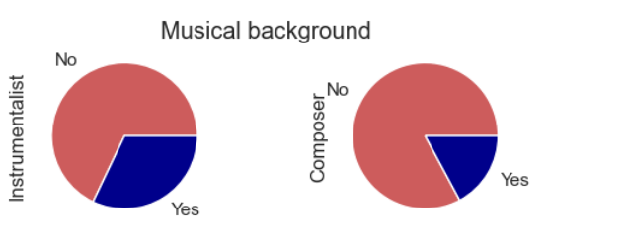
Pie diagram output:
Does music listeners are music composer or plays instruments? Below pie diagram shows that is not true for majority of the cases.

Slide 9
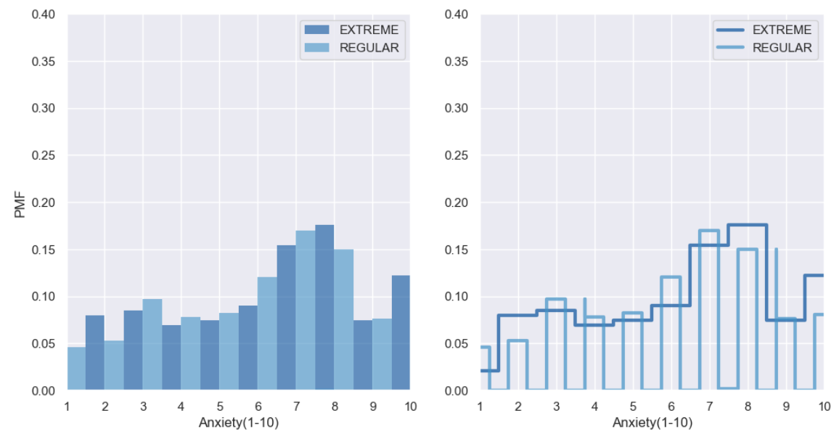
PMF and histogram output:
plotting of Anxiety based on hours per day music listening. Calculated the PMF based on filter applied on Hours per day column and plotting done between PMF and Anxiety level.

Slide 10
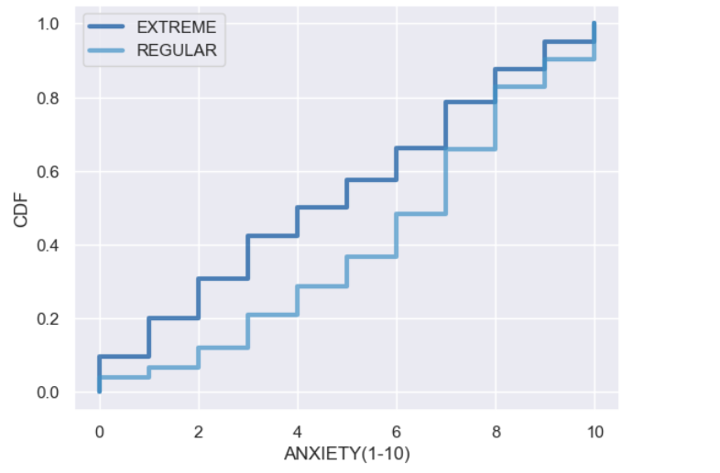
PMF and histogram output:
CDF distribution and Anxiety (EXTREME vs REGULAR) plotting.

Slide 11
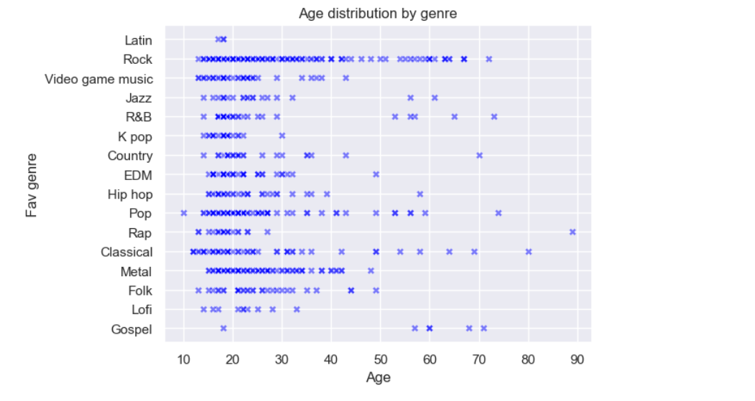
PMF and histogram output:
Scatter plot between genre and age variable. It shows Rock is the most diverse range of ages.

Slide 12
Bibliography :
https://www.kaggle.com/​
Thinkstats2.pdf​
www.statology.org​
https://www.projectpro.io​
YouTube​
https://www.khanacademy.org​
https://www.edureka.co/

Slide 13

Thank You!!

